Slide 1
SAS-Omnio Solar farm demo

Slide 2
Storyboard
SAS solar farm background – interesting facts
Need for condition based monitoring
Data generated by Solar farm and associated challenges
SAS-Omnio partnership to solve this challenge
Architecture
Omnio component
ESP component
Demo Dashboard
Other applications

Slide 3
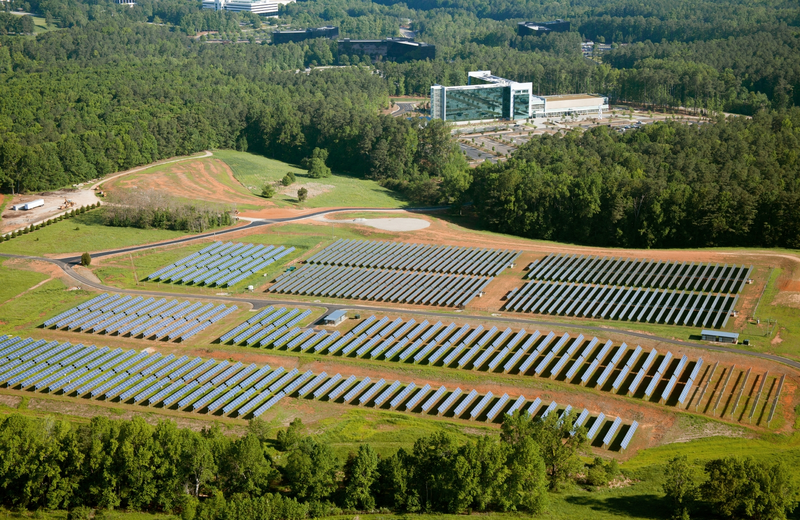
SAS Solar Farm
At a combined 2.3 MW in capacity, SAS’ solar farms are located on 12 acres at world headquarters in Cary, NC.
The photovoltaic (PV) solar arrays generate 3.6 million kilowatt-hours of clean, renewable energy each year.
The solar panel system is fitted with Ray Tracker that tilts the panels towards the sun as it moves across the sky.
The solar farms are providing energy to one of our campus buildings.
Notes:
10.000 panels
14 panels per string
Over 700 strings
Strings map to ~15 combiner boxes

Slide 4
Need for Condition based monitoring
Monitoring the solar farm and addressing the faults in the system is highly critical as it providing energy to the campus buildings.
The solar panels and the related hardware such as tracking motors, cables etc. are prone to failure due to exposure to harsh weather conditions.

Slide 5
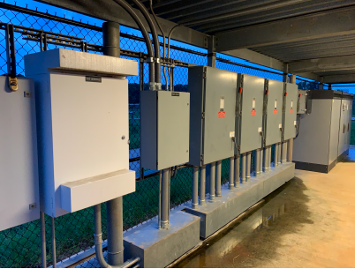
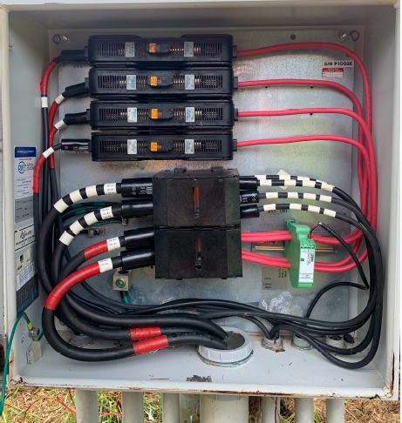
Solar farm hardware
Inverter and Monitoring devices
Combiner box

Slide 6
Solar farm data and associated challenges
The solar farm system has various sensors installed on both the combiner boxes and inverters that generate huge amount of data.
Granularity of data?
Current at String level
Temp, Status at a combiner box level
Sensor based weather data – irradiance (sun light measure), wind, humidity
Inverter data
The sensor data is collected in a gateway that communicates the data with other devices using Modbus protocol.
The data from each tag is stored across various Modbus registers in byte strings.
Other challenges?
How much time it took?
Holding Register | Format | Description | Strings
0 | UINT16 | Status of Current Sensor A3-1(0 = Normal, 16 - Short Circuit, 32 = No Comms, 64 = Error, 128 = disabled) | -
1 | FLOAT32 | CBX A3-1 Current 1 | 7
3 | FLOAT32 | CBX A3-1 Current 2 | 7
5 | FLOAT32 | CBX A3-1 Current 3 | 7
9 | INT16 | CBX A3-1 Temperature
Sample Modbus register point map of a combiner box

Slide 7
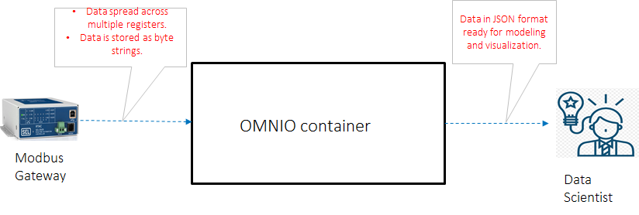
Data mapping challenge

Slide 8
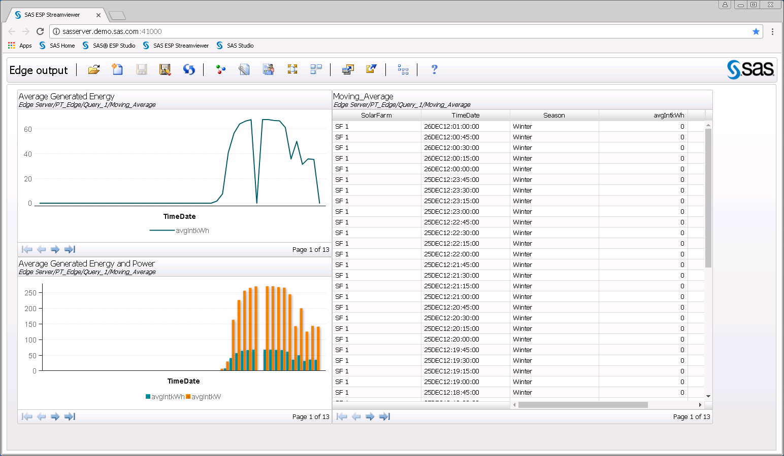

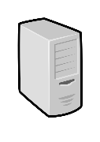

Architecture
JSON input
Edge environment
Omnio
Container
SAS ESP
Container
MQTT Broker
Modbus
ESP server
Omnio Edge
Mosquitto
Browser
Streaming Model
Solar Farm
Docker Platform
Host OS
Edge Server
(Intel NUC)
Notes:
Omnio container: 12 MB
ESP container: ~2 GB

Slide 9
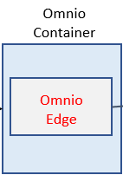
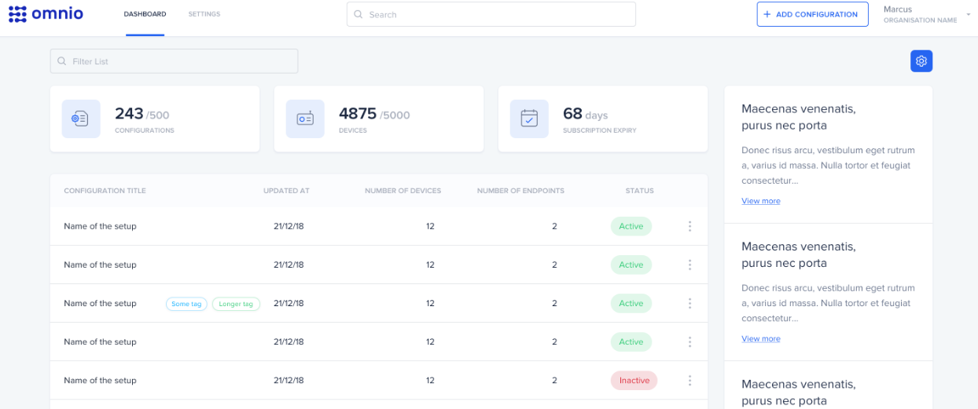
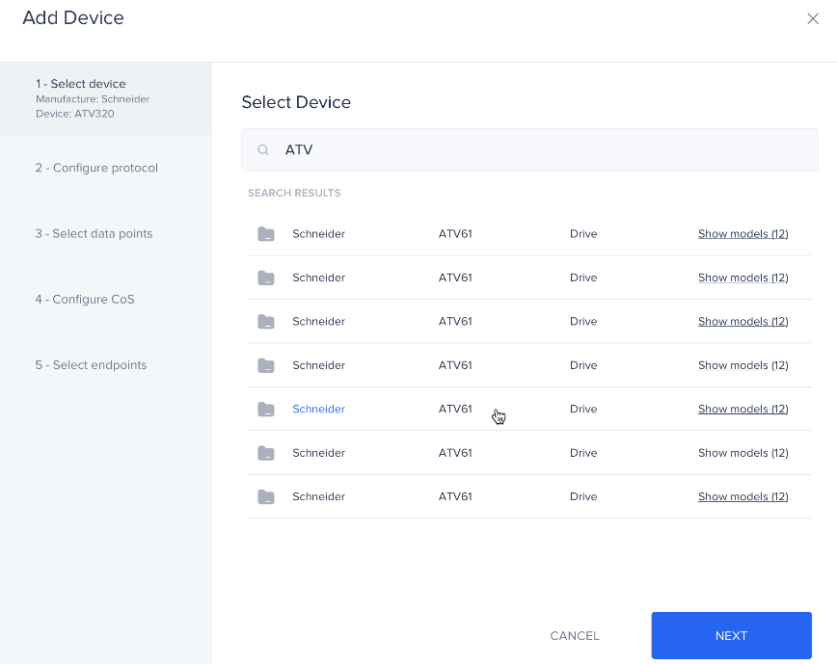
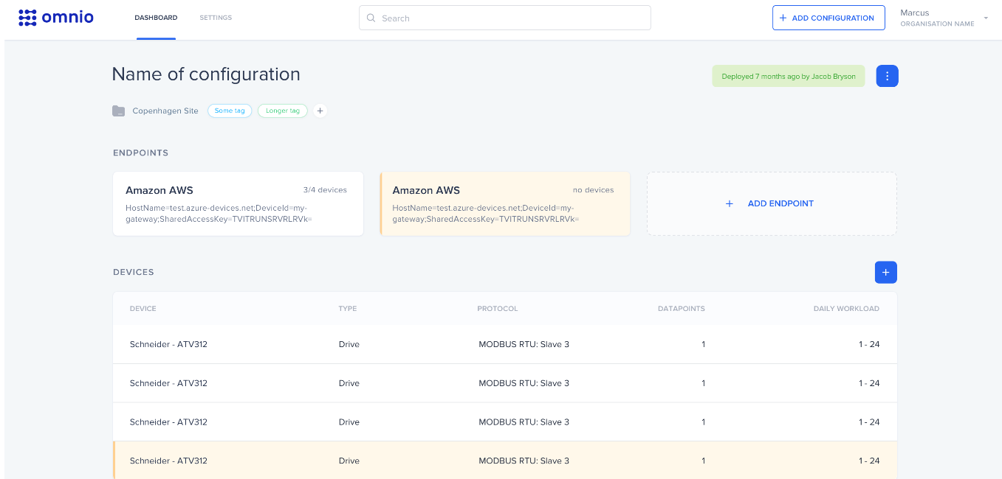
Omnio workflow

Slide 10
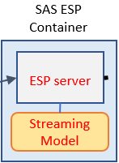
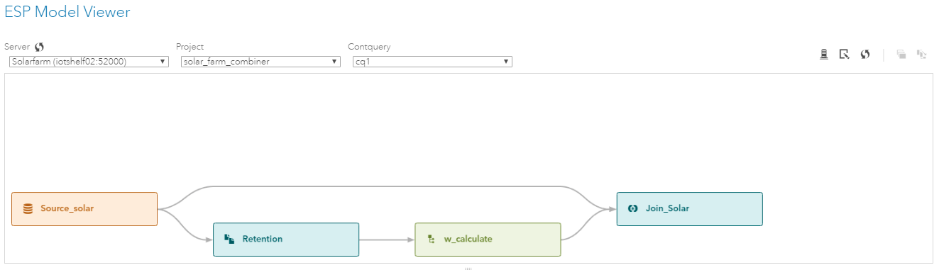
SAS Component

Slide 11
Subspace Tracking
Tracks the principal subspace (principal components) of K variables typically over time.
High-dimensional outlier detection by tracking the changes in​
The rank of the principal subspace​
The residual (or reconstruction error) of the principal subspace​
The projection angle (angle and previous subspace) between current observation
SAS Implementation Innovation
Monitor the relative or absolute angles of the principal subspace as well

Slide 12
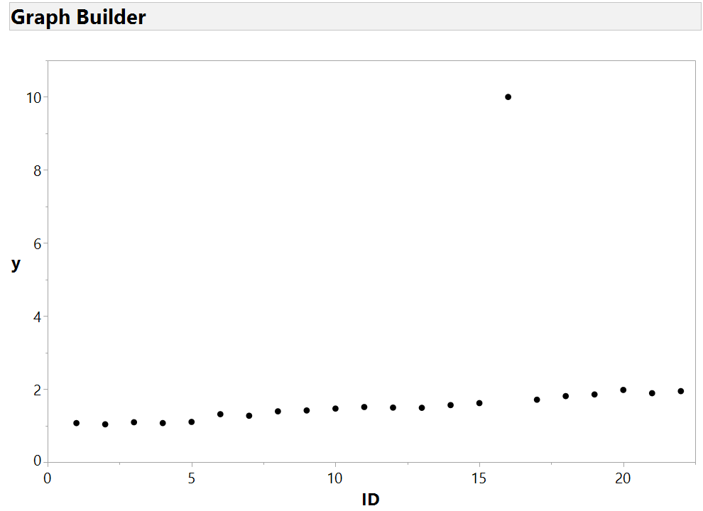


SAS® Subspace Tracking Overview
Angle Change in First Principal Component over Successive Windows
W3
Outlier
Outlier
W1
W2
W2
$$θ_{1}$$
$$θ_{2}$$
Small angle change
Window contains normal observations
Window contains outlier
Large angle change
Notes:
Subspace Tracking can be used to track outliers, degradation, and changes in subspace
We have created an angle method that uses the first principal component corresponding with sliding windows to detect outliers
Outliers correspond with large angle changes between successive windows
The solar panel “strings” converging into a single combiner box should behave similar to each other over time and any deviation can be identified by this technique.

Slide 13
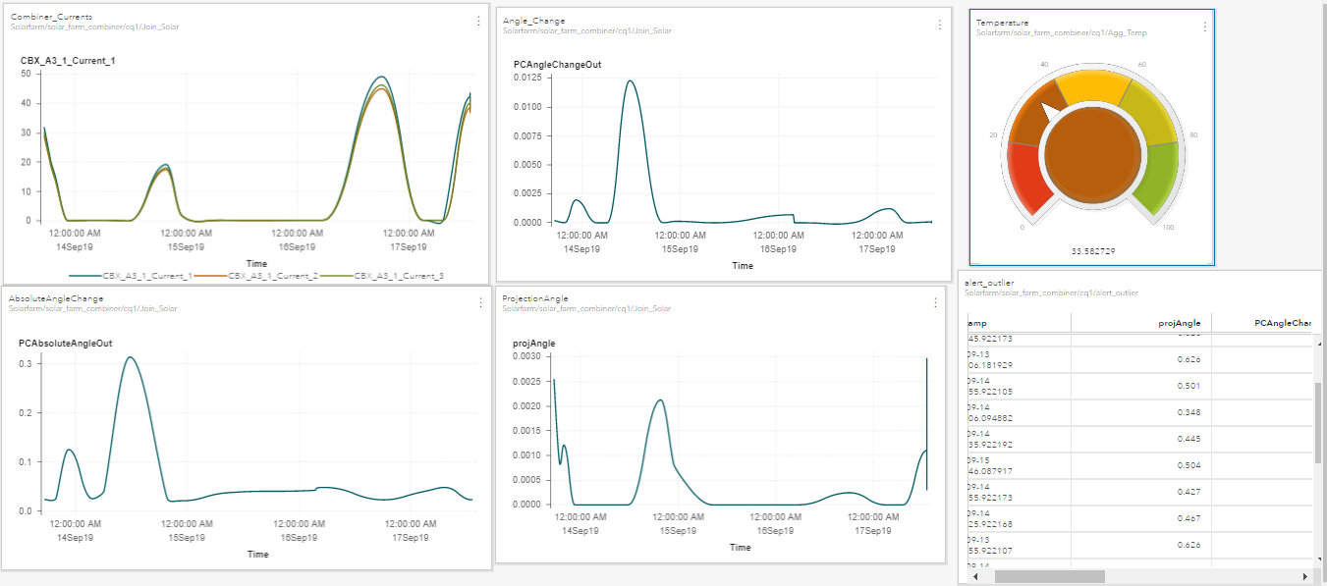
Dashboard

Slide 14
Demo

Slide 15
Demo abstract: Real-time Condition based monitoring for Solar farm
More than 10,000 panels on the SAS solar farm in Cary, NC produce approximately 3.6 million kilowatt-hours of clean, renewable energy each year. The solar panels and related hardware such as inverters, controllers, tracking motors, cables etc. are prone to failure due to exposure to harsh weather conditions. Monitoring the solar farm and addressing faults in a timely manner is critical to optimizing energy production and system reliability.​
This demo showcases how SAS and Omnio solve arguably the hardest and most frustrating part of Industrial IoT – accessing data from legacy industrial environments supporting execution of ML models on commodity edge hardware to generate real-time insights.

Slide 16
Demo flow
Modbus dataset
Omnio portal
Transformed data
Show raw data and discuss challenges associated with using this legacy data source for Analytics
Show Omnio portal to discuss the ease of creating a pipeline from legacy Modbus data to clean standardized data
Show what the output of the Omnio component looks like – JSON formatted dataset
ESP Project Design
Show the ease of creating an ESP project to consume the above data and perform streaming analytics
Analytics output from ESP
ESP dashboard 1: Output of “sub-space tracking”, 2- Operations dashboard based on Inverter data

Slide 17
Other applications

Slide 18
Other applications
This end-to-end capability is pertinent to a variety of Industrial IoT use cases that have one or more of the following characteristics:
Asset(s) publishing data on legacy or proprietary industrial protocols
There is value in being able to support condition based monitoring and predictive maintenance on a real-time basis
Scalability requirements to hundreds or thousands of Industrial assets
Need for deployment with commodity spec hardware at edge or cloud

Slide 19
Questions and Follow-ups?
Saurabh.Mishra@sas.com, IoT Product Management

